Slide 1


DATABASES PROJECT
2021
RETAIL STORES
Owens Vincentio - Javokhir Khusanov
DATABASES GROUP PROJECT: RETAIL STORES
01

Slide 2

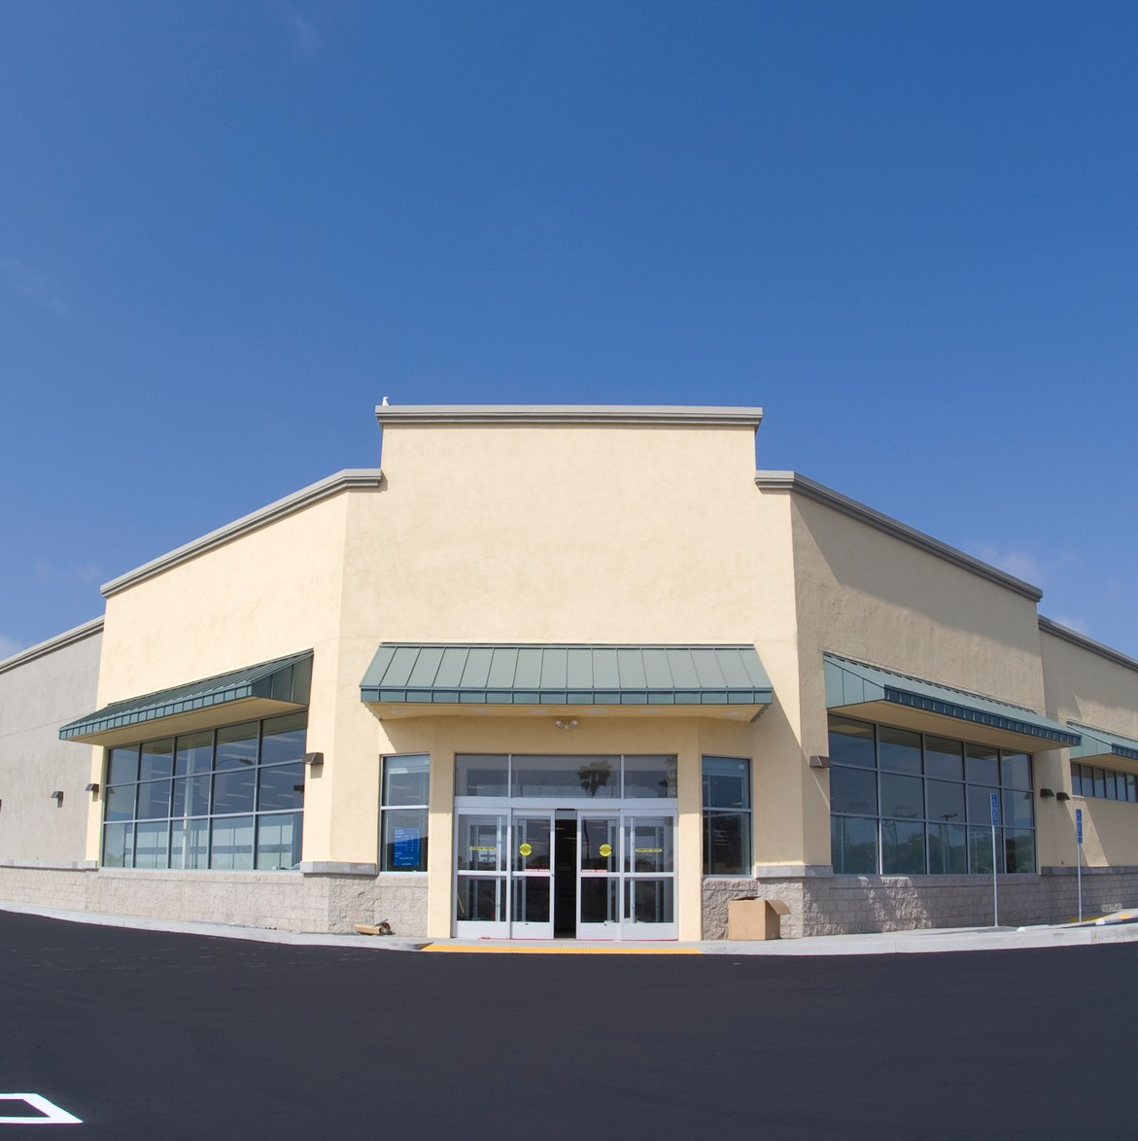

Contents
2021
Overview
Entities
DATABASES GROUP PROJECT: RETAIL STORES
ERD
Data Dictionary
DB Design Creating Tables Populating Data Creating View
02
Creating Index

Slide 3
Overview - Retail Stores
This application is about retail stores.
2021
Retail Store Management Database System captures changes specifically in human resources.
It is assumed that Retail Store number of branches in different locations. In our case, the branch is regarded as a retail store and its office.
Another assumption, relationship between Employee table and the other relevant tables, which are Department, Branch, and Warehouse, is that Employee manages the other tables.
Entry is made for every employee.
The objective is to keep track of changes in the organization's human resources management.
Distributor is an extranous entity that represents as supplier records. Operations table used to define many to many relationship between Distributor, Warehouse, and Branch tables.
DATABASES GROUP PROJECT: RETAIL STORES
03

Slide 4
Entities
2021
EMPLOYEE
EmployeeID First_Name Last_Name Title
Gender Location Email
Phone_Number
BRANCH
BranchID Branch_Name Location Employee_Qty
DEPARTMENT
Department_Name
DATABASES GROUP PROJECT: RETAIL STORES
DISTRIBUTOR
DistributorID Distributor_Name Location Product_Qty Phone_Number
WAREHOUSE
WarehouseID Location Product_Qty
04

Slide 5
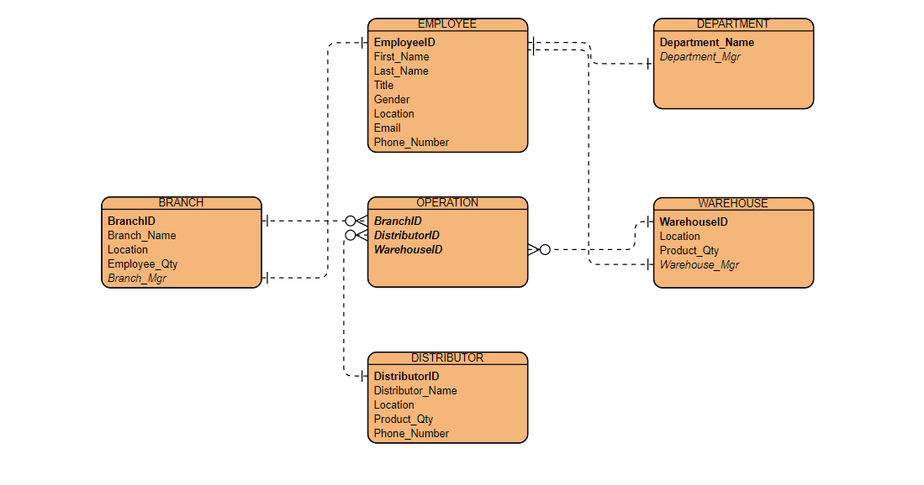
Entity Relation Diagram
2021
department
EMPLOYEE
DATABASES GROUP PROJECT: RETAIL STORES
Branch
OPERATIONS
warehouse
Distributor
05

Slide 6
Tables
2021
EMPLOYEE
EmployeeID First_Name Last_Name Title
Gender Location Email
Phone_Number
BRANCH
BranchID Branch_Name Location Employee_Qty Branch_Mgr (FK)
DISTRIBUTOR
DistributorID Distributor_Name Location Product_Qty Phone_Number
DATABASES GROUP PROJECT: RETAIL STORES
WAREHOUSE
WarehouseID Location Product_Qty Warehouse_Mgr (FK)
DEPARTMENT
Department_Name Department_Mgr (FK)
OPERATIONS
BranchID (FK) DistributorID (FK) WarehouseID (FK)
07

Slide 7
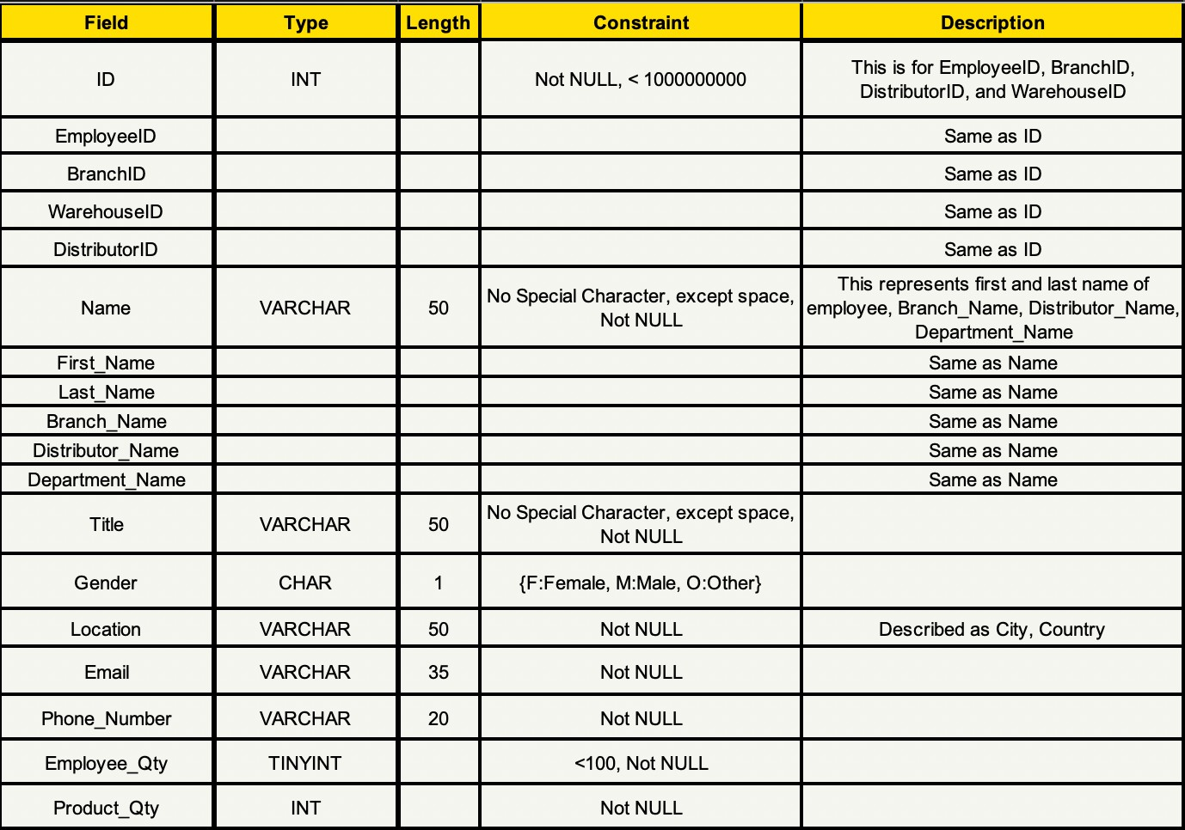
Data Dictionary
2021
DATABASES GROUP PROJECT: RETAIL STORES
06

Slide 8
Creating Schema
2021
DATABASES GROUP PROJECT: RETAIL STORES
CREATE SCHEMA retail_stores; USE retail_stores;
08

Slide 9
DATABASES GROUP PROJECT: RETAIL STORES
2021
Creating Tables
09

Slide 10
Creating Tables - EMPLOYEE
2021
EMPLOYEE
EmployeeID
First_Name
Last_Name
Title
Gender
Location
Email
Phone_Number
CREATE TABLE EMPLOYEE (
EmployeeID First_Name Last_Name Title
Gender
INT VARCHAR(50) VARCHAR(50) VARCHAR(50) CHAR(1)
NOT NULL, NOT NULL, NOT NULL, NOT NULL, NOT NULL,
DATABASES GROUP PROJECT: RETAIL STORES
CONSTRAINT EmployeeIDCheck CHECK ((EmployeeID > 0 ) AND EmployeeID < 1000000000), CONSTRAINT First_NameCheck CHECK (First_Name NOT LIKE '%[^A-Z]%'),
CONSTRAINT Last_NameCheck CHECK (Last_Name NOT LIKE '%[^A-Z]%'), CONSTRAINT GenderCheck CHECK (Gender = 'M' OR Gender = 'F' OR Gender = 'O'), CONSTRAINT TitleCheck CHECK (Title NOT LIKE '%[^A-Z]%'),
CONSTRAINT EmployeeIDPK PRIMARY KEY (EmployeeID)
);
10

Slide 11
Creating Tables - BRANCH
2021
BRANCH
BranchID
Branch_Name
Location
Employee_Qty
Branch_Mgr (FK)
CREATE TABLE BRANCH (
BranchID Branch_Name Location Employee_Qty EmployeeID
INT VARCHAR(50) VARCHAR(50) TINYINT
NOT NULL, NOT NULL, NOT NULL, NOT NULL, NOT NULL,
DATABASES GROUP PROJECT: RETAIL STORES
INT
CONSTRAINT BranchIDCheck CHECK ((BranchID > 0 ) AND BranchID < 1000000000),
CONSTRAINT Branch_NameCheck CHECK (Branch_Name NOT LIKE '%[^A-Z]%'),
CONSTRAINT Employee_QtyCheck CHECK ((Employee_Qty > 0 ) AND Employee_Qty < 100),
CONSTRAINT EmployeeIDCheck3 CHECK ((EmployeeID > 0 ) AND EmployeeID < 1000000000), CONSTRAINT BranchIDPK PRIMARY KEY (EmployeeID),
CONSTRAINT EmployeeIDFK2 FOREIGN KEY (EmployeeID)
REFERENCES EMPLOYEE(EmployeeID) ON UPDATE NO ACTION
ON DELETE NO ACTION
);
14

Slide 12
Creating Tables - DEPARTMENT
2021
DEPARTMENT
Department_Name
Department_Mgr (FK)
CREATE TABLE Department(
EmployeeID Department_Name
INT VARCHAR(50)
NOT NULL, NOT NULL,
DATABASES GROUP PROJECT: RETAIL STORES
CONSTRAINT Department_NameCheck CHECK (Department_Name NOT LIKE '%[^A-Z]%'),
CONSTRAINT EmployeeIDCheck4 CHECK ((EmployeeID > 0 ) AND EmployeeID < 1000000000), CONSTRAINT DepartmentIDPK PRIMARY KEY (EmployeeID),
CONSTRAINT EmployeeIDFK3 FOREIGN KEY (EmployeeID) REFERENCES EMPLOYEE(EmployeeID)
ON UPDATE NO ACTION ON DELETE NO ACTION
);
13

Slide 13
Creating Tables - DISTRIBUTOR
2021
CREATE TABLE Distributor( DistributorID INT
DISTRIBUTOR
DistributorID
Distributor_Name
Location
Product_Qty
Phone_Number
NOT NULL,
Distributor_Name | VARCHAR(50) | NOT NULL,
Location | VARCHAR(50) | NOT NULL,
Product_Qty | INT | NOT NULL,
Phone_Number | VARCHAR(20) | NOT NULL,
DATABASES GROUP PROJECT: RETAIL STORES
CONSTRAINT DistributorIDCheck CHECK ((DistributorID > 0 ) AND DistributorID < 1000000000), CONSTRAINT Distributor_NameCheck CHECK (Distributor_Name NOT LIKE '%[^A-Z]%'),
CONSTRAINT DistributorIDPK PRIMARY KEY (DistributorID)
);
15

Slide 14
Creating Tables - WAREHOUSE
2021
WAREHOUSE
WarehouseID
Location
Product_Qty
Warehouse_Mgr (FK)
CREATE TABLE WAREHOUSE(
WAREHOUSEID | INT | NOT NULL,
Location | VARCHAR(50) | NOT NULL,
Product_Qty | INT | NOT NULL,
EmployeeID | INT | NOT NULL,
DistributorID | INT | NOT NULL,
BranchID | INT | NOT NULL,
DATABASES GROUP PROJECT: RETAIL STORES
CONSTRAINT WAREHOUSEIDCheck CHECK ((WAREHOUSEID > 0 ) AND WAREHOUSEID < 1000000000),
CONSTRAINT EmployeeIDCheck5 CHECK ((EmployeeID > 0 ) AND EmployeeID < 1000000000), CONSTRAINT DistributorIDCheck1 CHECK ((DistributorID > 0 ) AND DistributorID < 1000000000), CONSTRAINT BranchIDCheck1 CHECK ((BranchID > 0 ) AND BranchID < 1000000000), CONSTRAINT WAREHOUSEIDPK PRIMARY KEY (WAREHOUSEID),
16

Slide 15
Creating Tables - OPERATIONS
2021
OPERATIONS
BranchID (FK)
DistributorID (FK)
WarehouseID (FK)
CREATE TABLE OPERATIONS(
NOT NULL, INT NOT NULL, INT NOT NULL,
BranchID INT
DistributorID WareHouseID
CONSTRAINT PrimaryPK1
PRIMARY KEY (BranchID, DistributorID, WareHouseID), FOREIGN KEY (BranchID)
DATABASES GROUP PROJECT: RETAIL STORES
CONSTRAINT BranchIDFK REFERENCES BRANCH(BranchID)
ON UPDATE NO ACTION ON DELETE NO ACTION,
CONSTRAINT DistributorIDFK
FOREIGN KEY (DistributorID)
REFERENCES DISTRIBUTOR(DistributorID) ON UPDATE NO ACTION
ON DELETE NO ACTION,
CONSTRAINT WareHouseIDFK FOREIGN KEY (WareHouseID) REFERENCES WAREHOUSE(WareHouseID)
ON UPDATE NO ACTION ON DELETE NO ACTION
11

Slide 16
2021
DATABASES GROUP PROJECT: RETAIL STORES
Populating
Tables
17

Slide 17
Populating Tables - EMPLOYEE
2021
EMPLOYEE
EmployeeID
First_Name
Last_Name
Title
Gender
Location
Email
Phone_Number
Should enter this before BRANCH, DEPARTMENT, WAREHOUSE due to FK constraint
INSERT INTO EMPLOYEE
(EmployeeID, First_Name, Last_Name, Title, Gender, Location, Email, Phone_Number)
VALUES (001000001, 'John', 'Smith', 'Accountant', 'M', 'Sydney, Australia', 'johnsmith@gmail.com', '+61 813 278 909');
INSERT INTO EMPLOYEE
(EmployeeID, First_Name, Last_Name, Title, Gender, Location, Email, Phone_Number)
VALUES (001000002, 'Jane', 'Miller', 'Cashier', 'F', 'Melbourne, Australia', 'millerz09@icloud.com', '+61 283 920 312');
DATABASES GROUP PROJECT: RETAIL STORES
INSERT INTO EMPLOYEE
(EmployeeID, First_Name, Last_Name, Title, Gender, Location, Email, Phone_Number)
VALUES (001000003, 'Dolly', 'Kramer', 'Stacker', 'F', 'Punggol, Singapore', 'dollydolly29@hotmail.com', '+65 231 342 997');
INSERT INTO EMPLOYEE
(EmployeeID, First_Name, Last_Name, Title, Gender, Location, Email, Phone_Number)
VALUES (001000004, 'Charlie', 'Storm', 'Customer Helper', 'M', 'California, USA', 'thorlightning@gmail.com', '+1 902 238 772');
INSERT INTO EMPLOYEE
(EmployeeID, First_Name, Last_Name, Title, Gender, Location, Email, Phone_Number)
VALUES (001000005, 'Hillary', 'Brown', 'Sales Representative', 'F', 'Montreal, Canada', 'hbrown@icloud.com', '+1 908 324 528');
18

Slide 18
Populating Tables - BRANCH
2021
BRANCH
BranchID
Branch_Name
Location
Employee_Qty
Branch_Mgr (FK)
Should enter this after EMPLOYEE due to FK constraint
INSERT INTO BRANCH
(BranchID, Branch_Name, Location, Employee_Qty, Branch_Mgr) VALUES (110101023, 'Secaucus', 'Teterboro NJ', 29, 001000001);
DATABASES GROUP PROJECT: RETAIL STORES
INSERT INTO BRANCH
(BranchID, Branch_Name, Location, Employee_Qty, Branch_Mgr) VALUES (110101024, 'Bayonne' ,'Queens NY', 36, 001000002);
INSERT INTO BRANCH
(BranchID, Branch_Name, Location, Employee_Qty, Branch_Mgr) VALUES (110101025, 'North Bergen', 'Manhattan NY', 41, 001000003);
INSERT INTO BRANCH
(BranchID, Branch_Name, Location, Employee_Qty, Branch_Mgr) VALUES (110101026, 'Kearny', 'Edison NJ', 35, 001000004);
INSERT INTO BRANCH
(BranchID, Branch_Name, Location, Employee_Qty, Branch_Mgr) VALUES (110101027, 'Teterboro', 'Long Island NY', 29, 001000005);
22

Slide 19
Populating Tables - DEPARTMENT
2021
DEPARTMENT
Department_Name
Department_Mgr (FK)
Should enter this after EMPLOYEE due to FK constraint
INSERT INTO DEPARTMENT
(Department_Name, Department_Mgr) VALUES ('Accounting', 001000001);
DATABASES GROUP PROJECT: RETAIL STORES
INSERT INTO DEPARTMENT
(Department_Name, Department_Mgr) VALUES ('Customer Service', 001000002);
INSERT INTO DEPARTMENT
(Department_Name, Department_Mgr) VALUES ('Human Resources', 001000003);
INSERT INTO DEPARTMENT
(Department_Name, Department_Mgr) VALUES ( 'Marketing', 001000004);
INSERT INTO DEPARTMENT
(Department_Name, Department_Mgr) VALUES ( 'Security', 001000005);
21

Slide 20
Populating Tables - DISTRIBUTOR
2021
DISTRIBUTOR
DistributorID
Distributor_Name
Location
Product_Qty
Phone_Number
Should enter this before WAREHOUSE due to FK constraint
INSERT INTO DISTRIBUTOR
( DistributorID, Distributor_Name, Location, Product_Qty, Phone_Number) VALUES (101010101, 'Whole Order', 'Buffalo, NY', 7767, '+1 347 200 970');
INSERT INTO DISTRIBUTOR
( DistributorID, Distributor_Name, Location, Product_Qty, Phone_Number) VALUES (101010106, 'Happy Distributers', 'Columbus, IN', 2356, '+1 568 685 560');
INSERT INTO DISTRIBUTOR
( DistributorID, Distributor_Name, Location, Product_Qty, Phone_Number) VALUES (101010102, 'Order Pros', 'Boston, MA', 9030, '+1 567 200 875');
INSERT INTO DISTRIBUTOR
( DistributorID, Distributor_Name, Location, Product_Qty, Phone_Number) VALUES (101010107, 'Inventory Wholesale', 'Chicago, IL', 2300, '+1 230 021 000');
DATABASES GROUP PROJECT: RETAIL STORES
INSERT INTO DISTRIBUTOR
( DistributorID, Distributor_Name, Location, Product_Qty, Phone_Number) VALUES (101010103, 'Order Pros', 'Bangor, ME', 1530, '+1 579 254 776');
INSERT INTO DISTRIBUTOR
( DistributorID, Distributor_Name, Location, Product_Qty, Phone_Number) VALUES (101010108, 'Bulk Demand', 'Chihuahua, Chihuahua', 5300, '+52 888 690
4146');
INSERT INTO DISTRIBUTOR
( DistributorID, Distributor_Name, Location, Product_Qty, Phone_Number) VALUES (101010104, 'Strict Supply', 'Manchester, NH', 3637, '+1 123 298
805');
INSERT INTO DISTRIBUTOR
( DistributorID, Distributor_Name, Location, Product_Qty, Phone_Number) VALUES (101010109, 'You To Retail', 'Austin, TX', 5300, '+1 512 000 728');
INSERT INTO DISTRIBUTOR
( DistributorID, Distributor_Name, Location, Product_Qty, Phone_Number) VALUES (101010105, 'Strict Supply', 'Barre, VT', 1265, '+1 321 982 058');
INSERT INTO DISTRIBUTOR
( DistributorID, Distributor_Name, Location, Product_Qty, Phone_Number) VALUES (101010110, 'Glorious Goods', 'Orlando, FL', 7268, '+1 912 726 828');
23

Slide 21
Populating Tables - WAREHOUSE
2021
WAREHOUSE
WarehouseID
Location
Product_Qty
Warehouse_Mgr (FK)
Should enter this after EMPLOYEE, BRANCH, DISTRIBUTOR due to FK constraint
INSERT INTO WAREHOUSE
(WarehouseID, Location, Product_Qty, Warehouse_Mgr) VALUES(001001001, 'Orlando, FL', 7260, 001000001);
INSERT INTO WAREHOUSE
(WarehouseID, Location, Product_Qty, Warehouse_Mgr) VALUES(001001002, 'Austin, TX', 5320, 001000002);
DATABASES GROUP PROJECT: RETAIL STORES
INSERT INTO WAREHOUSE
(WarehouseID, Location, Product_Qty, Warehouse_Mgr) VALUES(001001003, 'Chihuahua, Chihuahua', 4820, 001000003);
INSERT INTO WAREHOUSE
(WarehouseID, Location, Product_Qty, Warehouse_Mgr) VALUES(001001004, 'Chicago, IL', 2350, 001000004);
INSERT INTO WAREHOUSE
(WarehouseID, Location, Product_Qty, Warehouse_Mgr) VALUES(001001005, 'Columbus, IN', 2356, 001000005);
24

Slide 22
Populating Tables - OPERATIONS
2021
OPERATIONS
BranchID (FK)
DistributorID (FK)
WarehouseID (FK)
Should enter this after WAREHOUSE due to FK constraint
INSERT INTO OPERATIONS
(BranchID, DistributorID, WarehouseID) VALUES (110101023, 101010101, 001001001);
DATABASES GROUP PROJECT: RETAIL STORES
INSERT INTO OPERATIONS
(BranchID, DistributorID, WarehouseID) VALUES (110101024, 101010102, 001001002);
INSERT INTO OPERATIONS
(BranchID, DistributorID, WarehouseID) VALUES (110101025, 101010103, 001001003);
INSERT INTO OPERATIONS
(BranchID, DistributorID, WarehouseID) VALUES (110101026, 101010104, 001001004);
INSERT INTO OPERATIONS
(BranchID, DistributorID, WarehouseID) VALUES (110101026 101010105, 001001005);
19

Slide 23
Creating
2021
CREATE VIEW EMPLOYEE_END_USER AS
SELECT EmployeeID, First_Name, Last_Name, Title, Gender FROM EMPLOYEE;
DATABASES GROUP PROJECT: RETAIL STORES
View

Slide 24
Creating Index
2021
DATABASES GROUP PROJECT: RETAIL STORES
CREATE INDEX NAME_INDEX ON EMPLOYEE(First_Name);

Slide 25
Thank You!
2021
DATABASES GROUP PROJECT: RETAIL STORES

